Slide 1

Inferences on β₁
We are assuming the normal error regression model
where
β₀ and β₁ are parameters
X_{i} are known constants
ε_{i} are independent N(0,σ²)
Frequently, we are interested in drawing inferences about β₁, the slope of the regression line.

Slide 2
Inferences on β₁
For example, consider a market research analyst studying the relationship between sales (Y) and advertising expenditures (X).
The analyst may wish to obtain an interval estimate of β₁ because it will provide information on how many additional sales dollars, on average, are generated by an additional dollar of advertising.
We may also want to test if there is a linear relationship or not between X and Y.
If X has no linear effect on the value of Y, how does this show up in our model?

Slide 3
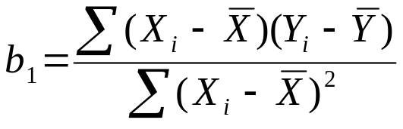
Inferences on β₁
When β₁ = 0, then E{Y} = β₀ + β₁X= β₀ and E{Y} is not affected by X.
To test this, we use a hypothesis test of the form:
H_{o}: β₁ = 0 vs H_{a}: β₁ ≠ 0
In order to derive confidence intervals or perform tests on β₁, we need the sampling distribution of b₁, the point estimate of β₁.
Recall,

Slide 4
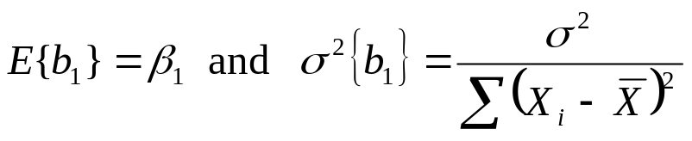
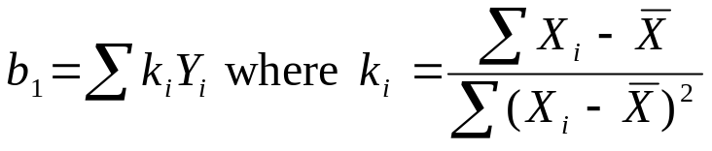
Inferences on β₁
The sampling distribution of b₁ is Normal with
To show this, recall that b₁ can be expressed as

Slide 5
Inferences on β₁
The normality of the sampling distribution follows from the fact that b₁ is a linear combination of the Y_{i}.
The Y_{i} are independently, normally distributed.
We also have that a linear combination of independent, normal random variables is normally distributed. (Theorum (A.40) in Appendix A)

Slide 6
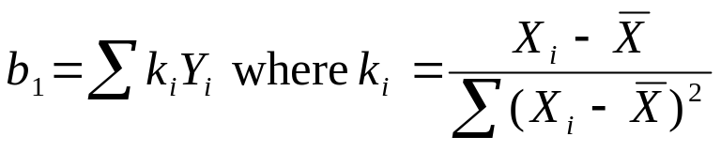
Inferences on β₁
Since the X_{i} are fixed, then the K_{i} are fixed.
Thus, b₁ is a linear combination of the Y_{i}.
To derive the variance of b₁, we use this fact as well as the fact that the Y_{i} are independent random variables each with variance σ².

Slide 7
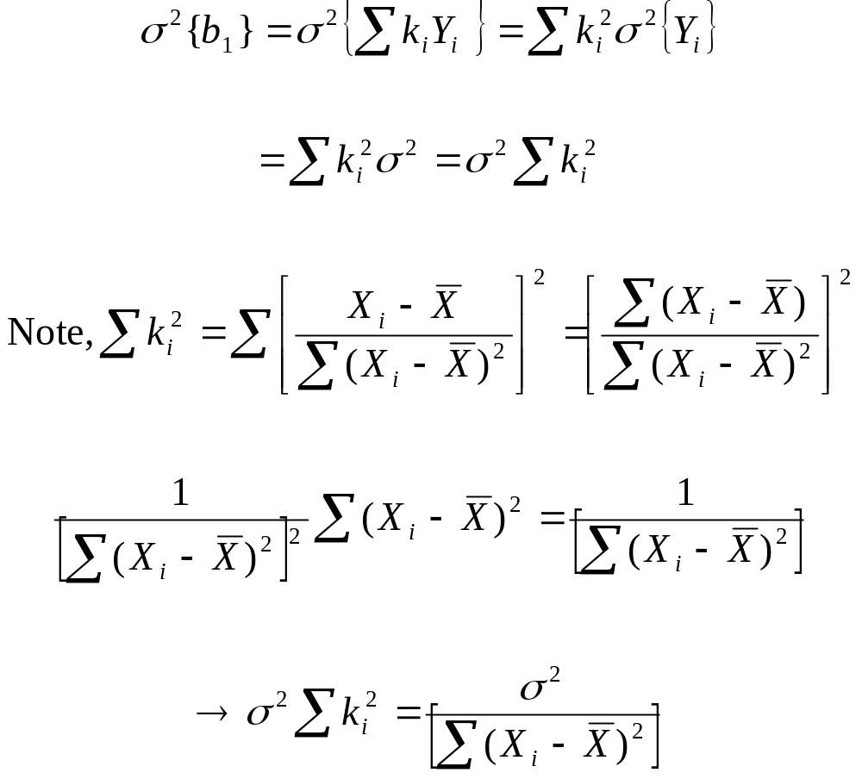
Inferences on β₁

Slide 8
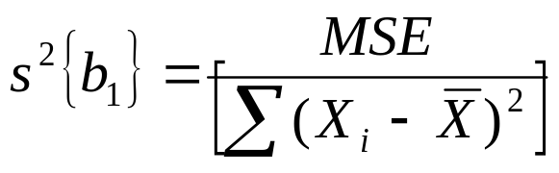
Inferences on β₁
In practice, we do not know the true variance of b₁, since we do not know the true variance of the error terms σ².
Instead of using the true variance of the error terms σ², we use its unbiased estimator, the MSE.
This gives us an unbiased estimate of σ² {b₁}, which we denote as s²{b₁}.
To get an unbiased estimator of σ{b₁}, s{b₁}, we use the positive square root.

Slide 9
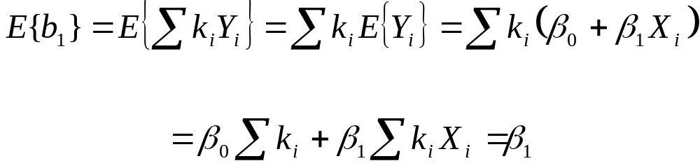
Inferences on β₁
The coefficients k_{i} have two properties that we will use in deriving the expected value of b₁.
∑ k_{i} = 0
∑ k_{i} X_{i} = 1
where the last step follows from the two properties listed for coefficients k_{i}.

Slide 10


Inferences on β₁
Recall that b₁ has minimum variance among all unbiased
linear estimators of the form
where the c_{i} are arbitrary constants.
To prove this, note that since the estimator is unbiased,

Slide 11

Inferences on β₁
By plugging β₀ + β₁ X_{i} in place of E{Y_{i}}, we obtain
For this to be true, ∑ c_{i} = 0 and ∑ c_{i} X_{i} = 1 must be true.
The variance of the estimator is

Slide 12

Inferences on β₁
Define c_{i} = k_{i} + d_{i}, where the k_{i} are the least squares constants
and d_{i} are arbitrary constants. Then
In the derivation of the variance of b₁, we showed that

Slide 13

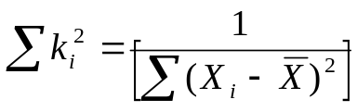
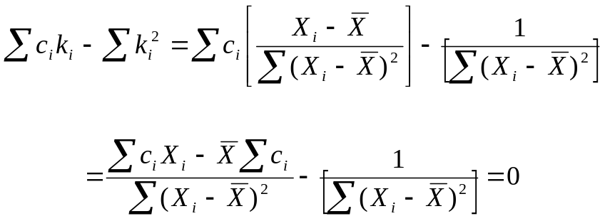
Inferences on β₁
Now note,
We also showed before,
Thus
where the last step uses ∑ c_{i} = 0 and ∑ c_{i} X_{i} = 1

Slide 14
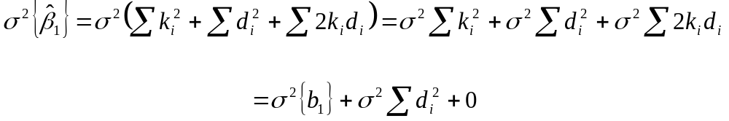

Inferences on β₁
Thus we have
Note, the variance is at a minimum when
But, this is only possible if each d_{i} =0. Then c_{i} = k_{i} + d_{i} = k_{i} for all i. This implies that c_{i} Ξ k_{i}.
Thus, the least squares estimator b₁ has minimum variance among all unbiased linear estimators.

Slide 15
Inferences on β₁
Why is it important that b₁ has minimum variance among all unbiased linear estimators?
The smaller the variance, the more precise our estimate is, that is the estimate will tend to be closer to the true parameter.
This allows us to calculate smaller confidence intervals.
This also allows us to have more power for our hypothesis tests.

Slide 16
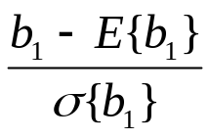
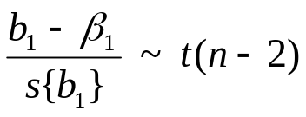
Inferences on β₁
Since b₁ is distributed normal, than the statistic
has a standard normal distribution.
However, we need to estimate σ{b₁} with s{b₁} The resulting statistic has a t distribution with n-2 degrees of freedom. (n-2 since we estimate β₀ and β₁)
This is written as

Slide 17
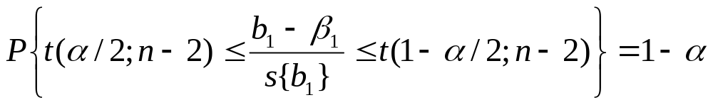
Inferences on β₁
We denote t(α/2;n-2) as the (α/2)100 percentile of the t distribution with n-2 degrees of freedom. Thus, the probability of a t statistic with n-2 degrees of freedom being less than t(α/2;n-2) is α/2.
Because of the symmetry of the t distribution, we have that
t(α/2;n-2) = -t(1-α/2;n-2)
For example, for α=.05 and n=20, we have that t(.025,18)=-2.1 and t(.975,18)=2.1, thus t(.025,18)= -t(.975,18).
Since our statistic follows a t distribution, we have

Slide 18
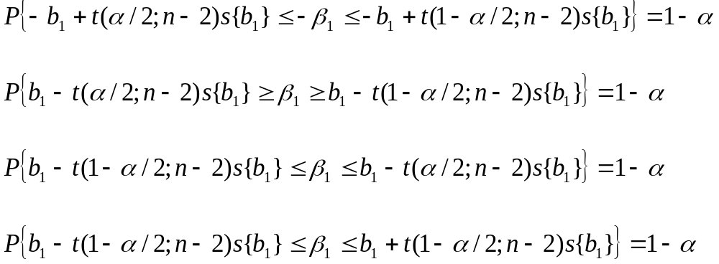

Inferences on β₁
Rearranging the terms, we obtain
Thus, our (1-α)100% confidence interval is

Slide 19
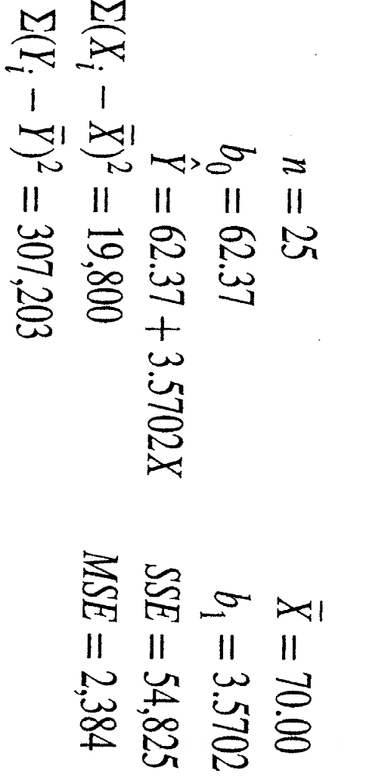
Inferences on β₁
Consider the Toluca example
In class: calculate 95% CI for β₁ (hint: t(.975;23) = 2.069

Slide 20
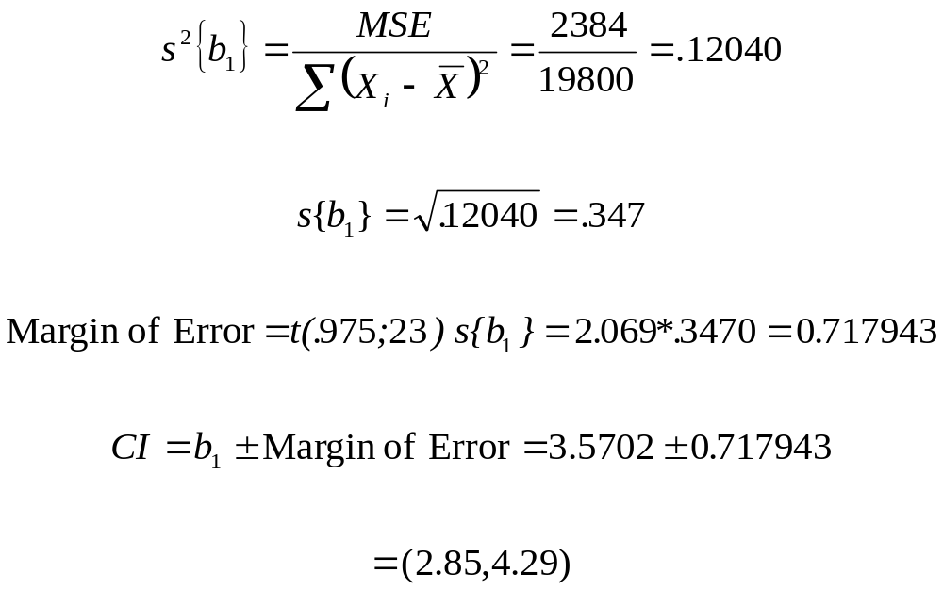
Inferences on β₁
Thus, with 95% confidence, we estimate that the mean number of work hours increases somewhere between 2.85 to 4.29 hours for each additional unit in the lot. (SAS Betas)

